Slide 1
Data Science
Introduction

Slide 2
Definitions
Data science is an
interdisciplinary field of scientific methods, processes, algorithms and systems to
extract knowledge or insights from data in various forms,
either structured or unstructured,
similar to data mining.

Slide 3
It employs techniques and theories drawn from many fields within the broad areas of mathematics, statistics, information science, and computer science.

Slide 4
Data science is the study of
where information comes from,
what it represents and
how it can be turned into a valuable resource in the creation of business.

Slide 5
turn raw data into valuable business information

Slide 6
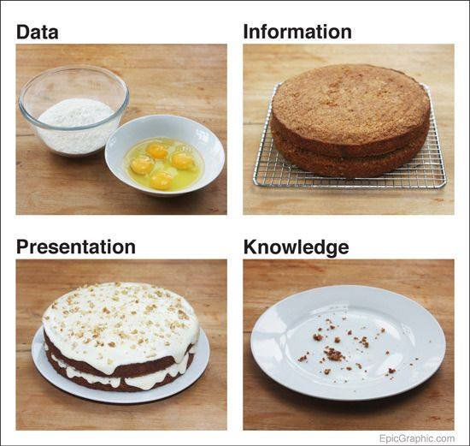
Data

Slide 7
Artificial Intelligence
Data science and machine learning
Machine learning is often incorporated in data science. Machine learning is an artificial intelligence (AI) tool that essentially automates the data-processing portion of data science. Machine learning integrates advanced algorithms that learn on their own and can process massive amounts of data in a fraction of the time it would take a human.

Slide 8
Big Data Analytics
The process of converting large amounts of unstructured raw data, retrieved from different sources to a data product useful for organizations forms the core of Big Data Analytics.
Structured data
Unstructured data

Slide 9
The CRISP-DM methodology that stands for Cross Industry Standard Process for Data Mining
SEMMA Methodology (Sample, Explore, Modify, Model, and Asses.)

Slide 10
One of the most important tasks in big data analytics is statistical modeling, meaning supervised and unsupervised classification or regression problems.
Once the data is cleaned and preprocessed, available for modeling, care should be taken in evaluating different models with reasonable loss metrics and then once the model is implemented, further evaluation and results should be reported.

Slide 11
Apache Hadoop
software library is a framework
distributed processing of large data sets across clusters of computers using simple programming models.
Spark™: A fast and general compute engine for Hadoop data. Spark provides a simple and expressive programming model that supports a wide range of applications, including ETL, machine learning, stream processing, and graph computation.
Mahout™: A Scalable machine learning and data mining library.

Slide 12
Big data
IBM – 3V
Volume ( size)
Velocity ( speed)
Variety ( diversity, many types )
-- Veracity (accuracy.)

Slide 13
Big Data Challenge
Data Acquisition
High Volume
High Velocity
Security
Analytics

Slide 14
DS Components
Statistics
Visualization
Domain Experience
Data Engineering
Computing

Slide 15
Types of DS
Business Analyst
Developers
Researchers
Tools :
Hadoop,
R
Python
Statistics

Slide 16
Useful in
Medicine Research
Economics
Business Modeling
Science

Slide 17
Big Data Analytics - Data Scientist -Role
Programming in a statistical package such as: R, Python, SAS, SPSS, or Julia
Able to clean, extract, and explore data from different sources
Research, design, and implementation of statistical models
Deep statistical, mathematical, and computer science knowledge

Slide 18
Jobs
Data Analyst
Data Scientist

Slide 19
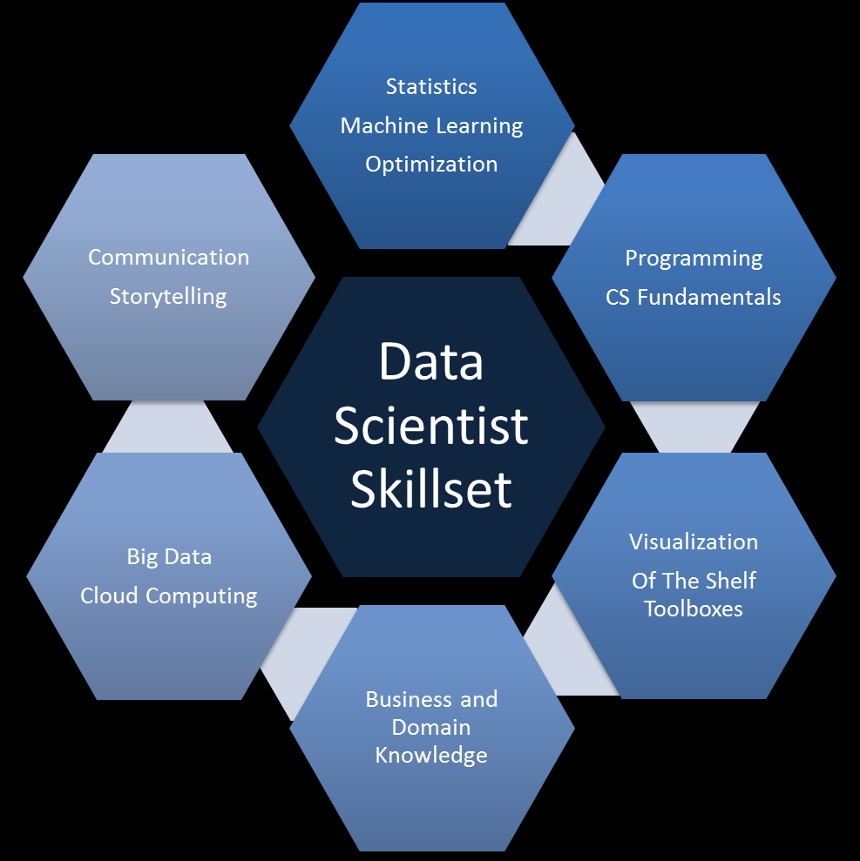

Slide 20

Mis-Understanding Data

